Slide 1
Applied Cryptography extended Euclidean algorithm , square-and-multiply algorithm, primality testing, subgroup, coset
Liangfeng Zhang
School of Information Science and Technology
ShanghaiTech University

Slide 2
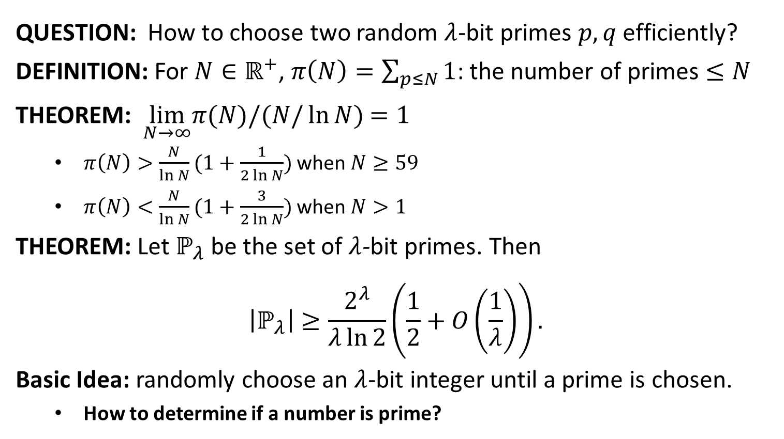
Choose Random Primes
QUESTION: How to choose two random $λ$-bit primes $p,q$ efficiently?
DEFINITION: For $N∈ℝ^{+}$, $π\left(N\right)=\sum_{p≤N}{1}$: the number of primes $≤N$
THEOREM: $\lim_{N→∞}π(N)/(N/\ln{N})$ $=1$
$π\left(N\right)>\frac{N}{\ln{N}}(1+\frac{1}{2\ln{N}})$ when $N≥59$
$π\left(N\right)<\frac{N}{\ln{N}}(1+\frac{3}{2\ln{N}})$ when $N>1$
THEOREM: Let $ℙ_{λ}$ be the set of $λ$-bit primes. Then
$$\left|ℙ_{λ}\right|≥\frac{2^{λ}}{λ\ln{2}}\left(\frac{1}{2}+O\left(\frac{1}{λ}\right)\right).$$
Basic Idea: randomly choose an $λ$-bit integer until a prime is chosen.
How to determine if a number is prime?
Primality testing

Slide 3
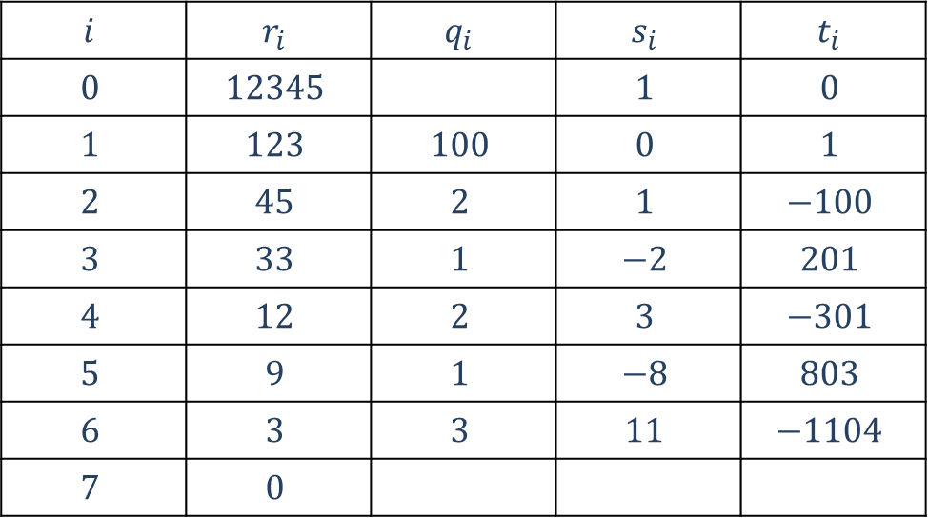
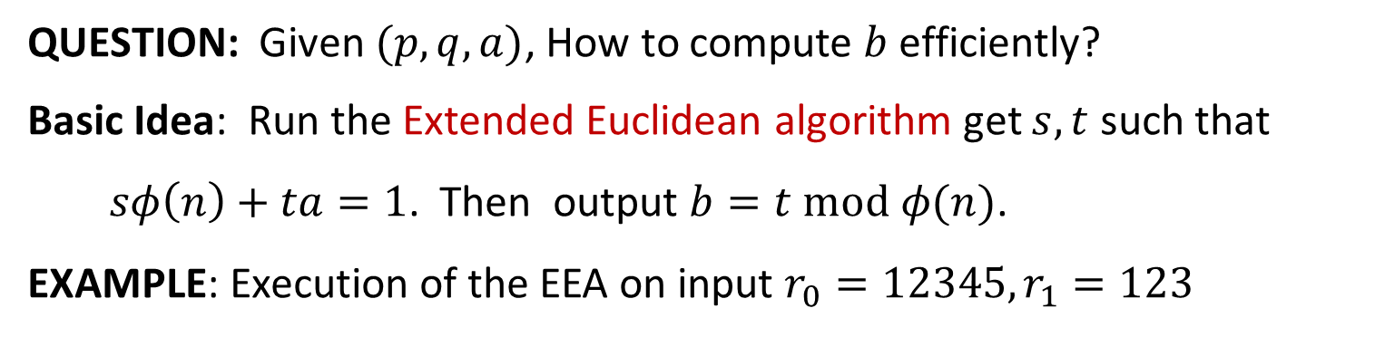
Computing Public Key
QUESTION: Given $(p,q,a)$, How to compute $b$ efficiently?
Basic Idea: Run the Extended Euclidean algorithm get $s,t$ such that
$sφ\left(n\right)+ta=1$. Then output $b=t mod φ(n)$.
EXAMPLE: Execution of the EEA on input $r_{0}=12345, r_{1}=123$
$$i$$ | $$r_{i}$$ | $$q_{i}$$ | $$s_{i}$$ | $$t_{i}$$
$$0$$ | $$12345$$ |  | $$1$$ | $$0$$
$$1$$ | $$123$$ | $$100$$ | $$0$$ | $$1$$
$$2$$ | $$45$$ | $$2$$ | $$1$$ | $$−100$$
$$3$$ | $$33$$ | $$1$$ | $$−2$$ | $$201$$
$$4$$ | $$12$$ | $$2$$ | $$3$$ | $$−301$$
$$5$$ | $$9$$ | $$1$$ | $$−8$$ | $$803$$
$$6$$ | $$3$$ | $$3$$ | $$11$$ | $$−1104$$
$$7$$ | $$0$$

Slide 4
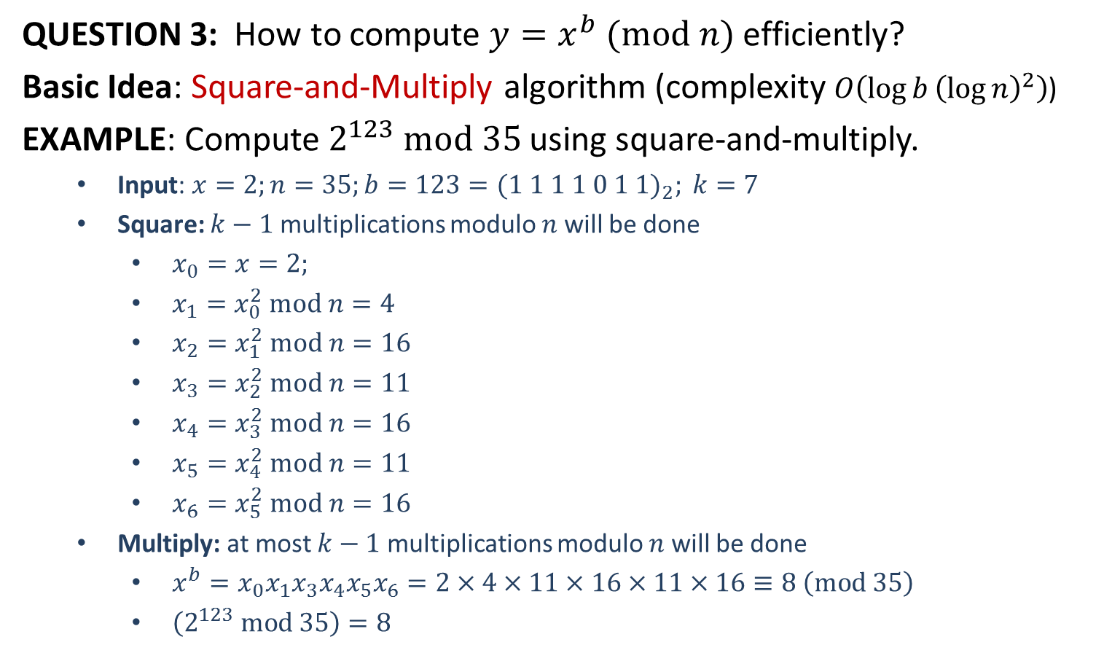
Encrypt and Decrypt Efficiently
QUESTION 3: How to compute $y=x^{b} (mod n)$ efficiently?
Basic Idea: Square-and-Multiply algorithm (complexity $O\left(\log{b}{\left(\log{n}\right)}^{2}\right)$)
EXAMPLE: Compute $2^{123} mod 35$ using square-and-multiply.
Input: $x=2;n=35;b=123={(1 1 1 1 0 1 1)}_{2}; k=7$
Square: $k−1$ multiplications modulo $n$ will be done
$x_{0}=x=2;$
$x_{1}=x_{0}^{2} mod n=4$
$x_{2}=x_{1}^{2} mod n=16$
$x_{3}=x_{2}^{2} mod n=11$
$x_{4}=x_{3}^{2} mod n=16$
$x_{5}=x_{4}^{2} mod n=11$
$x_{6}=x_{5}^{2} mod n=16$
Multiply: at most $k−1$ multiplications modulo $n$ will be done
$x^{b}=x_{0}x_{1}x_{3}x_{4}x_{5}x_{6}=2×4×11×16×11×16≡8 \left(mod 35\right)$
$\left(2^{123} mod 35\right)=8$

Slide 6
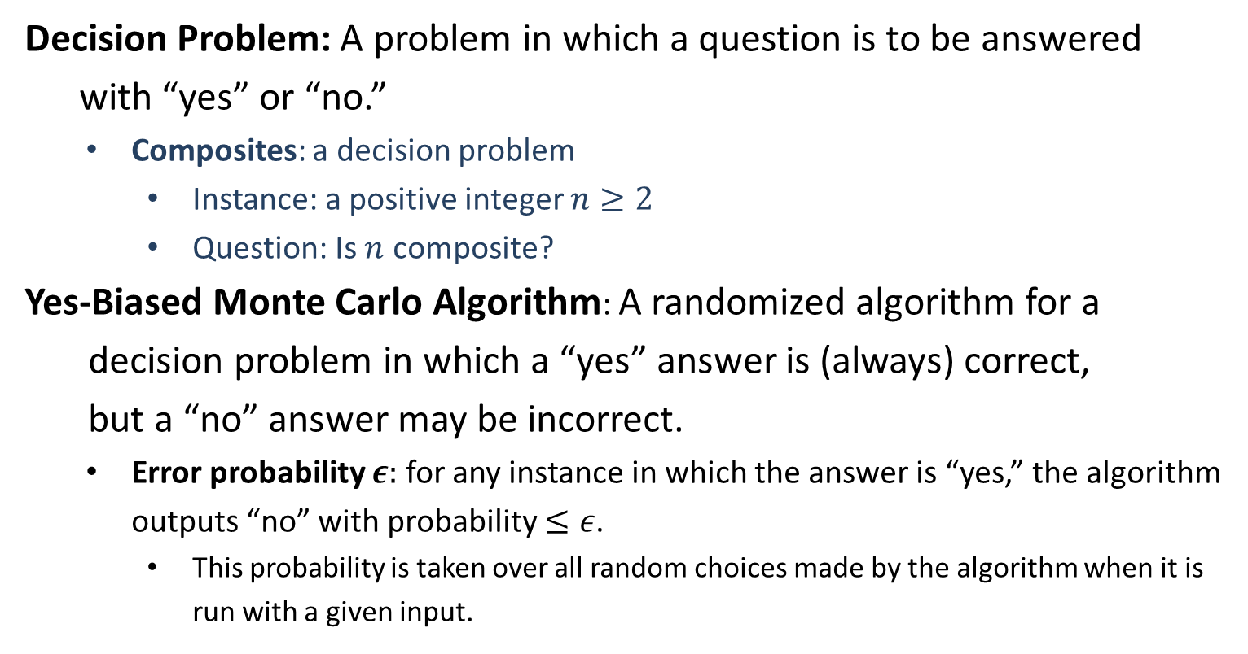
Primality Testing
Decision Problem: A problem in which a question is to be answered
with “yes” or “no.”
Composites: a decision problem
Instance: a positive integer $n≥2$
Question: Is $n$ composite?
Yes-Biased Monte Carlo Algorithm: A randomized algorithm for a
decision problem in which a “yes” answer is (always) correct,
but a “no” answer may be incorrect.
Error probability $ε:$ for any instance in which the answer is “yes,” the algorithm outputs “no” with probability $≤ε$.
This probability is taken over all random choices made by the algorithm when it is run with a given input.

Slide 7
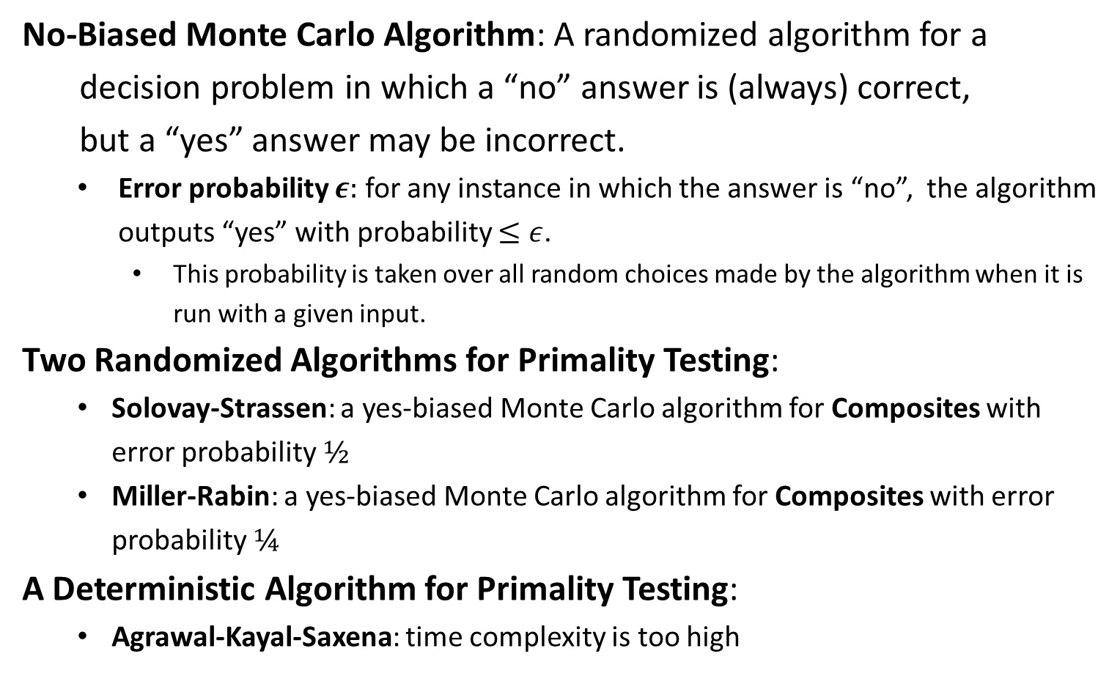
Primality Testing
No-Biased Monte Carlo Algorithm: A randomized algorithm for a
decision problem in which a “no” answer is (always) correct,
but a “yes” answer may be incorrect.
Error probability $ε:$ for any instance in which the answer is “no”, the algorithm outputs “yes” with probability $≤ε$.
This probability is taken over all random choices made by the algorithm when it is run with a given input.
Two Randomized Algorithms for Primality Testing:
Solovay-Strassen: a yes-biased Monte Carlo algorithm for Composites with error probability $½$
Miller-Rabin: a yes-biased Monte Carlo algorithm for Composites with error probability $¼$
A Deterministic Algorithm for Primality Testing:
Agrawal-Kayal-Saxena: time complexity is too high

Slide 9
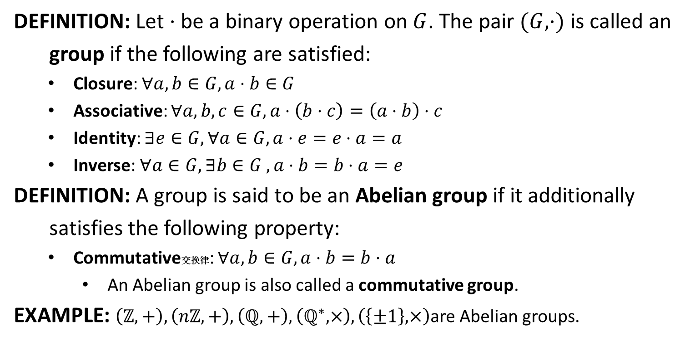
Group
DEFINITION: Let $⋅$ be a binary operation on $G$. The pair $(G,⋅)$ is called an
group if the following are satisfied:
Closure: $∀a,b∈G, a⋅b∈G$
Associative: $∀a,b,c∈G, a⋅\left(b⋅c\right)=\left(a⋅b\right)⋅c$
Identity: $∃e∈G, ∀a∈G, a⋅e=e⋅a=a$
Inverse: $∀a∈G, ∃b∈G , a⋅b=b⋅a=e$
DEFINITION: A group is said to be an Abelian group if it additionally
satisfies the following property:
Commutative交换律: $∀a,b∈G, a⋅b=b⋅a$
An Abelian group is also called a commutative group.
EXAMPLE: $\left(ℤ,+\right), \left(nℤ, +\right), \left(ℚ,+\right), \left(ℚ^{∗}, ×\right),\left(\left\{±1\right\}, ×\right)$are Abelian groups.

Slide 10

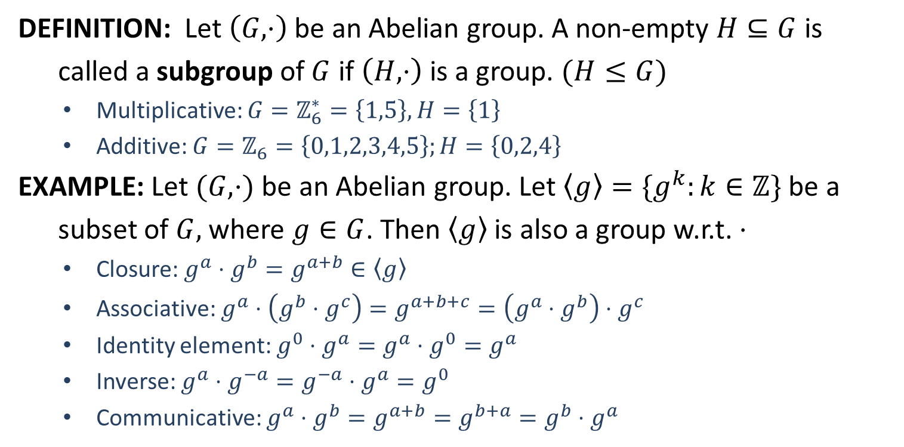
Subgroup
DEFINITION: Let $\left(G,⋅\right)$ be an Abelian group. A non-empty $H⊆G$ is
called a subgroup of $G$ if $\left(H,⋅\right)$ is a group. $(H≤G)$
Multiplicative: $G=ℤ_{6}^{∗}=\left\{1,5\right\},H=\left\{1\right\}$
Additive: $G=ℤ_{6}=\left\{0,1,2,3,4,5\right\};H=\left\{0,2,4\right\}$
EXAMPLE: Let $(G,⋅)$ be an Abelian group. Let $〈g〉=\{g^{k}:k∈ℤ\}$ be a
subset of $G,$ where $g∈G$. Then $〈g〉$ is also a group w.r.t. $⋅$
Closure: $g^{a}⋅g^{b}=g^{a+b}∈〈g〉$
Associative: $g^{a}⋅\left(g^{b}⋅g^{c}\right)=g^{a+b+c}=\left(g^{a}⋅g^{b}\right)⋅g^{c}$
Identity element: $g^{0}⋅g^{a}=g^{a}⋅g^{0}=g^{a}$
Inverse: $g^{a}⋅g^{−a}=g^{−a}⋅g^{a}=g^{0}$
Communicative: $g^{a}⋅g^{b}=g^{a+b}=g^{b+a}=g^{b}⋅g^{a}$
Trivial subgroups
$\left\{1\right\}≤G$
$G≤G$

Slide 11
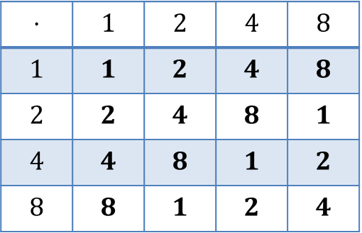

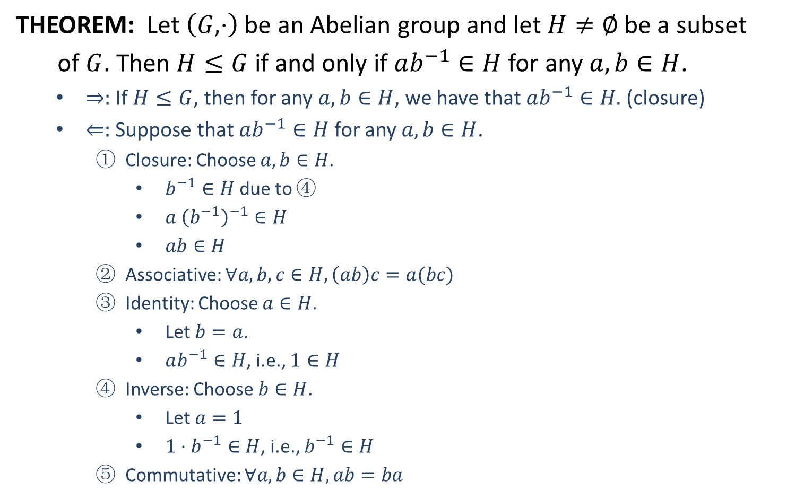
Subgroup
THEOREM: Let $\left(G,⋅\right)$ be an Abelian group and let $H≠∅$ be a subset
of $G$. Then $H≤G$ if and only if $ab^{−1}∈H$ for any $a,b∈H$.
$⇒:$ If $H≤G$, then for any $a,b∈H$, we have that $ab^{−1}∈H.$ (closure)
$⇐:$ Suppose that $ab^{−1}∈H$ for any $a,b∈H$.
Closure: Choose $a,b∈H$.
$b^{−1}∈H$ due to ④
$a {\left(b^{−1}\right)}^{−1}∈H$
$ab∈H$
Associative: $∀a,b,c∈H, \left(ab\right)c=a(bc)$
Identity: Choose $a∈H$.
Let $b=a$.
$ab^{−1}∈H$, i.e., $1∈H$
Inverse: Choose $b∈H$.
Let $a=1$
$1⋅b^{−1}∈H$, i.e., $b^{−1}∈H$
Commutative: $∀a,b∈H, ab=ba$
EXAMPLE
$G=ℤ_{15}^{∗}=\{1,2,4,7,8,11,13,14\}$
$H=\{1,2,4,8\}$
Show that $H≤G$.
$1^{−1}=1, 2^{−1}=8$
$4^{−1}=4, 8^{−1}=2$
$$⋅$$ | $$1$$ | $$2$$ | $$4$$ | $$8$$
$$1$$ | $$1$$ | $$2$$ | $$4$$ | $$8$$
$$2$$ | $$2$$ | $$4$$ | $$8$$ | $$1$$
$$4$$ | $$4$$ | $$8$$ | $$1$$ | $$2$$
$$8$$ | $$8$$ | $$1$$ | $$2$$ | $$4$$

Slide 13

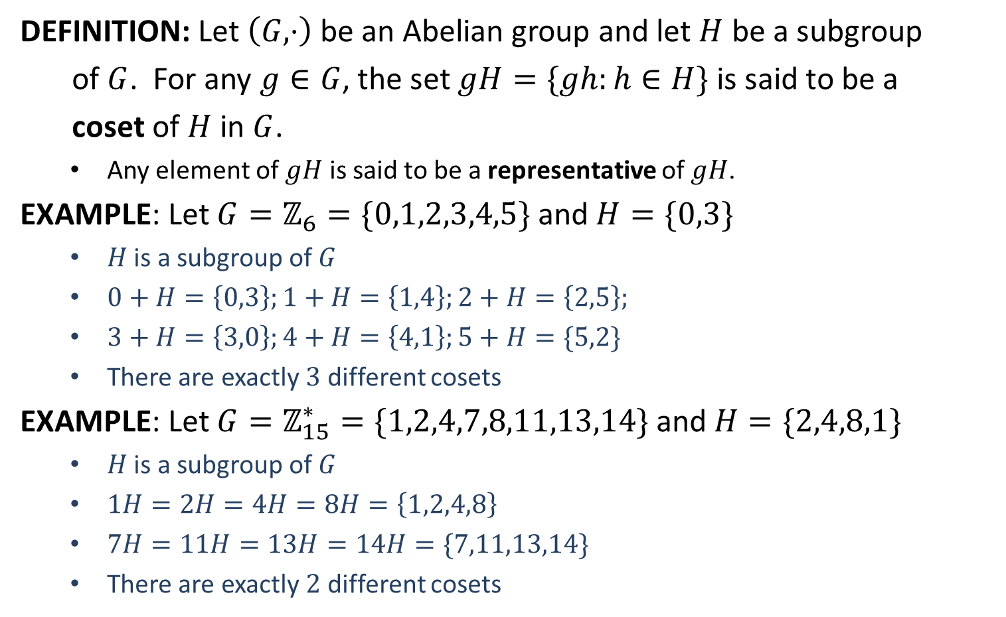
Coset
DEFINITION: Let $\left(G,⋅\right)$ be an Abelian group and let $H$ be a subgroup
of $G$. For any $g∈G$, the set $gH=\{gh:h∈H\}$ is said to be a
coset of $H$ in $G$.
Any element of $gH$ is said to be a representative of $gH$.
EXAMPLE: Let $G=ℤ_{6}=\{0,1,2,3,4,5\}$ and $H=\{0,3\}$
$H$ is a subgroup of $G$
$0+H=\left\{0,3\right\};1+H=\left\{1,4\right\};2+H=\left\{2,5\right\};$
$3+H=\left\{3,0\right\};4+H=\left\{4,1\right\};5+H=\{5,2\}$
There are exactly $3$ different cosets
EXAMPLE: Let $G=ℤ_{15}^{∗}=\{1,2,4,7,8,11,13,14\}$ and $H=\{2,4,8,1\}$
$H$ is a subgroup of $G$
$1H=2H=4H=8H=\left\{1,2,4,8\right\}$
$7H=11H=13H=14H=\{7,11,13,14\}$
There are exactly $2$ different cosets
The number of cosets* $\left|H\right|=|G|$

